Slide 1


Customer Food ordering data ANALYSIS
Aadil A - AF05259524

Slide 2

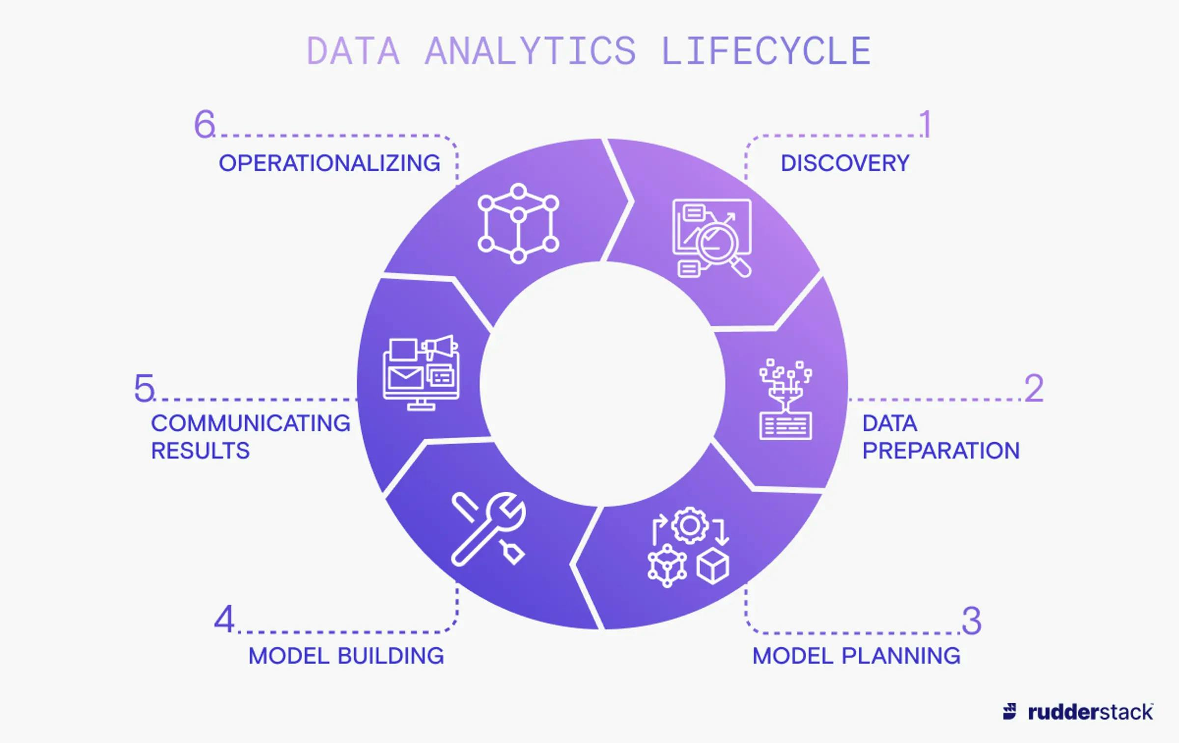
Data analysis lifecycle

Slide 3

What is RESTAURANT KPI data Analysis ?
Customer Ordering data analysis is the process of examining and interpreting information about how customers behave when they Order. Businesses use this analysis to understand their customers better and make data-driven decisions about things like:
Product development and marketing: By understanding what Food customers are buying together, how much they're spending, and what demographics they fall into, Food Spots can develop targeted selling campaigns and make informed decisions about what products to stock.
Sales and promotions: Customer data can help businesses identify which products are most popular during certain times of year, and tailor promotions accordingly.
Customer experience: Analyzing Online and Offline Food Ordering data can help businesses identify areas where the customer experience can be improved, such as by streamlining the checkout process or personalizing recommendations.

Slide 4

Why customer Ordering data Analysis ?
Restaurant KPI data analysis is crucial for businesses in the retail industry to understand their customers' behavior and optimize their strategies. This specific dataset provides valuable insights into food ordering habits in India, focusing on many between 2021 and 2023.

Slide 5

Problem Statement
The project aims to gain a deeper understanding of customer ordering patterns using the Customer Ordering Dataset. It can help explore customer choices, ideal food, and predict selling volume.

Slide 6

Aim
By analyzing this data, we hope to uncover insights such as:
Customer demographics: Understanding the typical customer profile (age, gender) for different food categories and restaurants.
Purchasing behavior: Analyzing trends in purchase frequency, quantity, and total spending.
Product popularity: Identifying the most popular product categories across different varieties and food spots.
Payment preferences: Understanding the preferred payment methods (cash, credit card, debit card) used by different customer segments.
Seasonal trends: Analyzing how customer habits vary throughout the year.
Hotel performance: Comparing customer behavior and spending patterns across the restaurant.

Slide 7
methodologies
NumPy: Provides support for efficient numerical computations and array operations.
Pandas: Offers data manipulation and analysis tools through dataframes.
Matplotlib: Enables creating static, interactive, and animated visualizations.
Seaborn: Builds on Matplotlib to provide a high-level interface for drawing attractive statistical graphics.
MySQL Connector/Python: Loads the cleaned dataset into a MySQL database for structured storage and Power BI connectivity.

Slide 8
Project Architecture
Data Ingestion: The raw customer_shopping_data.csv is loaded into a Python environment for processing.
Preprocessing: Pandas and NumPy clean the data, engineer features (total_amount, date parts), normalize numeric columns, and one-hot encode categorical fields.
Exploratory Analysis: Matplotlib and Seaborn generate charts covering category sales, demographics, payment methods, seasonality, and mall performance.
Normalization: Scikit-learn's MinMaxScaler scales numeric features (age, quantity, price, total_amount) to a comparable range, preparing the data for future modeling.
Storage: The cleaned dataset is loaded into a MySQL database via mysql-connector-python.
Reporting: Power BI connects to MySQL to build an interactive KPI dashboard for stakeholders.

Slide 9

Hardware and Software Requirements
Processor: Intel Core i5 or equivalent (minimum), Intel Core i7 or higher (recommended)
RAM: 8 GB (minimum), 16 GB or more (recommended)
Storage: 256 GB SSD (minimum), 512 GB SSD or more (recommended)
Graphics: Integrated graphics for basic visualization, dedicated GPU for more intensive visualizations
Display: Full HD monitor (1920x1080 resolution) or higher
Internet Connection: Stable internet connection for downloading datasets and libraries

Slide 10

SOFTWARE REQUIREMENTS:
Operating System:
Windows 10 or higher
macOS 10.14 (Mojave) or higher
Linux (any modern distribution)
Programming Languages:
Python 3.6 or higher
Python Libraries:
pandas: For data manipulation and analysis.
numpy: For efficient numerical computations and array operations.
matplotlib: For static, interactive, and animated visualizations.
seaborn: For high-level statistical data visualization.
mysql-connector-python: For loading cleaned data into a MySQL database.
Database: MySQL Server 8.0 or higher, used as the structured storage layer connected to Power BI.

Slide 11

IDE/Text Editor:
Jupyter Notebook/JupyterLab (recommended for EDA)
Visual Studio Code
PyCharm

Slide 12

Summary
This customer restaurant data analysis project offers a valuable opportunity to gain insights into restaurant landscape. Using a Python-based cleaning and feature-engineering pipeline, a MySQL-backed data layer, and Power BI for data visualization, we can effectively uncover trends and patterns that can inform strategic decisions for businesses operating in the city.

